Slide 1
Linux Operating System
Security Basics

Slide 2
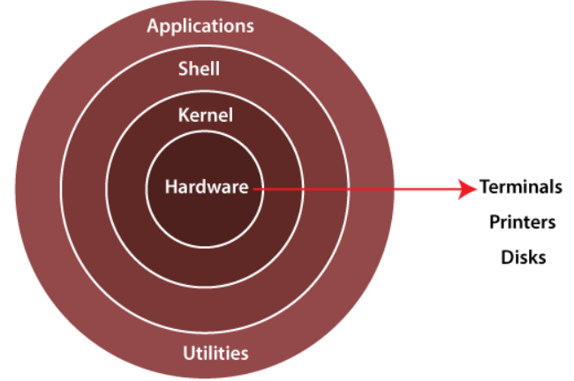
Architecture of Linux System

Slide 3
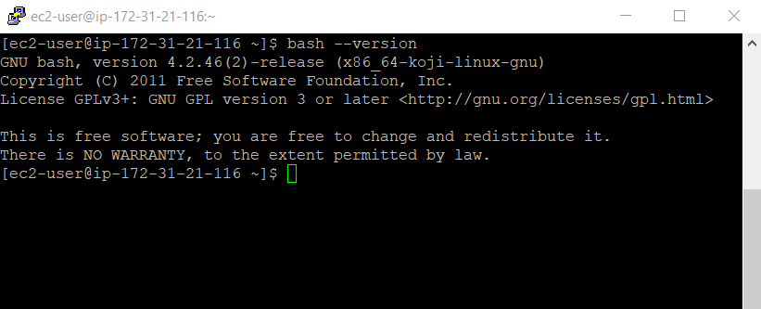
Key Components
Kernel
  Core of the operating system
  Interacts directly with the hardware
  Manages the system and user input/output. Processes, files, memory and devices.
Shell
  Used to interact with the kernel
  User input commands through the shell and kernel perform the commands

Slide 4
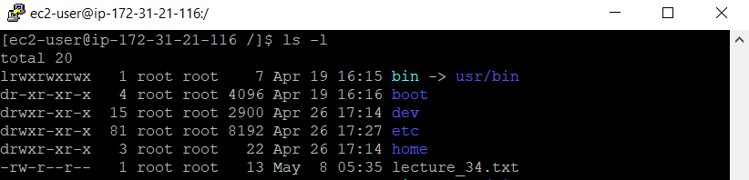
File Systems
Files
  A file is the basic unit of storage for data. Usually stored on physical media such as hard drives.
  Represented by “-” in the command line interface (CLI)
Directory
  A directory is a special type of file. Linux uses directories to hold information about other files. The equivalent of folders in Windows.
  Represented by a letter “d” in the CLI

Slide 5
Partitions & Privileges
/ - Root
  Every single file and directory starts from the root directory
  Only the root user has write privileges under this directory
  ./root is not same as /
  /root which is the home directory of the user root
/bin
  Contains binary executables
  Common Linux commands are found here
  ps, ls, ping, grep, cp, mv etc.
/etc
  Contains configuration files required by all programs
  Most applications will have a directory under /etc with all its configurations

Slide 6
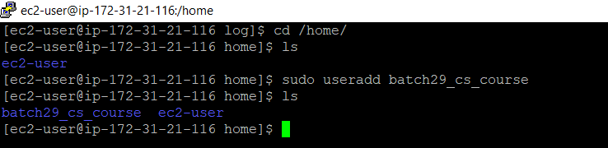
Partitions & Privileges
/var
  Contains files that are expected to grow or change constantly
  Referred to as variable files
  Application logs are usually found in /var/log
/tmp
  Contains temporary files
  They are deleted when the systems reboot.
/home
  This is where the home directories for all the users are located
  Personal files can be stored here

Slide 7
Permissions & Owners
Each file or directory in linux is assigned three type of owner
User
  Is the owner of the file
  When you create a file, you become the owner of the file
  You may also change this ownership later
Group
  Group consists of several users
  This is the one way to manage users in a multi-user environment
Other
  All users of the system

Slide 8
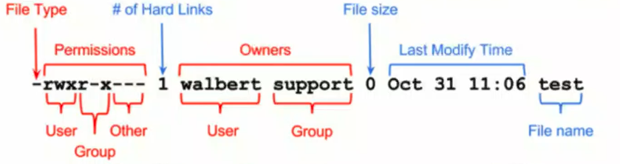
Permissions & Owners
Each file or directory in linux is has the following three type of permissions
Read: can view or copy
Write: can modify, create
Execute: can run the file (if executable) or enter the directory

Slide 9
Permissions & Owners
These permissions are represented by a octal value or binary
  Read (r): 4 (100)
  Write (w): 2 (010)
  Execute (x): 1 (001)
These numbers can be combined to represent the entire permission set for the owner type
N# | 0 | 1 | 2 | 3 | 4 | 5 | 6 | 7
Perm | --- | --x | -w- | -wx | r-- | r-x | rw- | rwx

Slide 10
Change File Permissions
Use chmod command to change the permissions on a file in linux.
  Can you guess the permissions in numbers on file given below ?
    -rw-r--r-- 1 sajid students 13 2022-05-11 08:29 lecture_on_os_basic_security.txt
  chmod 666 lecture_on_os_basic_security.txt
  Now if you list file lecture_on_os_security.txt
    -rw-rw-rw- 1 sajid students 13 2022-05-11 08:29 lecture_on_os_basic_security.txt
These numbers can be combined to represent the entire permission set for the owner type

Slide 11
Change File Ownership
Use chown command to change the ownership of a file in linux.
  chown <new_user_name>:<new_user_group> <filename>
  In our example, if you want to change the user owner and group to root, you can use the chown command like this:
    sudo chown root:root lecture_on_os_basic_security.txt
  Now if you list file lecture_on_os_basic_security.txt
    -rw-rw-rw- 1 root root 13 2022-05-11 08:29 lecture_on_os_basic_security.txt

Slide 12
Pentest Monkey
Pentestmonkey is a site that many Pentesters access to get cheat sheets and understand vulnerabilities and fixes. It has not been updated recently but the data and information is still relevant today.
  In this exercise, access http://pentestmonkey.net/
Search for Linux and read two or three articles to get familiar with the type of information that is available. Some information may be too technical however this exercise it to share resources that may be helpful in understanding and fixing vulnerabilities in the future.

